Slide 1
Unit 4
Part B
Economics in Cloud
Abhishek Bhattacherjee

Slide 2
Contents
Cloud Economics :
Developing an Economic Strategy
Exploring the Costs
Laws of cloudonomics
Cost estimation

Slide 3
Cloud economics!
Cloud economics is the study of cloud computing costs and benefits and the economic principles that underpin/support them.

Slide 4
Developing an Economic Strategy
Reducing operating costs and optimizing IT environments are pivotal/crucial to understanding and being able to compare the cost models behind provisioning on-premise and cloud-based environments.
The pricing structures used by public clouds are typically based on utility-centric pay-per-usage models, enabling organizations to avoid up-front infrastructure investments.
These models need to be assessed against the financial implications of on-premise infrastructure investments and associated total cost-of-ownership commitments

Slide 5
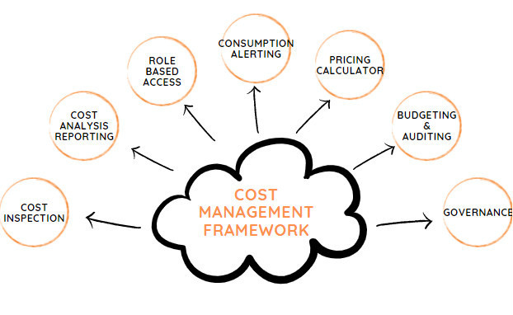

Slide 6
In detail…
1. Visibility on Cloud Inventory
According to a recent survey of IT professionals, 75% report, they lack visibility of their cloud resources. This lack of visibility into resources in the cloud can lead to poor management of those resources. Effective cloud cost management begins with an in-depth analysis of your entire infrastructure. And if some resources in the cloud are going unused due to lack of awareness, but the organization is still paying for them, cloud costs will climb unnecessarily – and cut into the infrastructure savings and other financial benefits the cloud can bring. Admins who have access to a single pane of glass and detailed Resource Dashboards are equipped to better organize, manage, and optimize that ecosystem across all accounts, clouds, departments, and teams.
2. Cost Analytics
Complete visibility on the cloud services used, the actual usage patterns and trends is the first step. No matter your cloud environment, in addition to tracking what you have spent, it is important to project what you will be spending. You need consolidated as well granular details in the form of interactive graphical and tabular reports across multiple dimensions, time frames in a multi-cloud environment to correlate data for analysis and reporting against business objectives.

Slide 7
In detail…
3. Role Based Access
Permit users to actively manage the infrastructure after setting an Enterprise-wide mechanism that clearly defines permissions and accessibility within the platform. Limit the data and actions visible to users by organizations and roles and identify who launched, terminated, or changed infrastructure, and what they did to take corrective action and control costs.
4. Controlled Stack Templates
A crucial characteristic of any DevOps team is to enable teams more autonomy over-provisioning resources without the red tape and extensive time delay of traditional IT environments. If it is implemented without the accompanying automation and process best practices, decentralized teams have the potential to produce convoluted and non-standard security rules, configurations, storage volumes, etc. and therefore drive up costs. Using predefined stack templates, Administrators can bake in security, network, and instance family/size configurations, so that the process of deploying instances is not only faster but aligned with the Departmental user’s roles and privileges and ensures only specific Resources are provisioned.

Slide 8
In detail…
5. Automated Alerts and Notifications
Stay on top of day-to-day changes in your environment, and participate in the critical decision by sharing standard and custom built reports with details on cost, usage, performance with stakeholders. Automated alerts and notifications about authorization failures, budget overruns, cost spikes, untagged infrastructure result in increased visibility and accountability.
6. Policy Based Governance
Use cloud-based governance tools to track cloud usage and costs and alert administrators when the total usage for the account is greater than a certain value or when the total usage for a vendor specific product is greater than a certain value helps control cost. Schedule operational hours to automatically shut down & start virtual machines, and automated events that alert administrators on volumes that have been disassociated from Virtual machines (standalone VMs) for more than a set number of days. In short, use integrated data sources, metadata, or custom tags to define a set of rules that lead to improved cost management, reporting and optimization.

Slide 9
In detail…
7. Budgets
Define and allocate budgets for Departments, cost centers, projects and ensure approval mechanisms to avoid cloud cost overrun by sending out alerts when thresholds are breached. Use the Showback report to chargeback Departments for their cloud usage and limit the cloud cost and use of resources. This alignment of cost with value ensures the anticipated business benefit once the cloud resources are in production

Slide 10
Exploring
The costs
• Up-front costs for the purchase and deployment of on-premise IT resources tend to be high. Examples of up-front costs
for on-premise environments can include hardware, software, and the labor required for deployment.
• Up-front costs for the leasing of cloud-based IT resources tend to be low. Examples of up-front costs for cloud-based
environments can include the labor costs required to assess and set up a cloud environment.
Up-Front Costs
Up-front costs are associated with the initial investments that organizations need to make in order to fund the IT resources they intend to use. This includes both the costs associated with obtaining the IT resources, as well as expenses required to deploy and administer them.

Slide 11
On-going Costs
• On-going costs for the operation of cloud-based IT resources can also vary, but often exceed the on-going costs of on-premise
IT resources (especially over a longer period of time). Examples include virtual hardware leasing fees, bandwidth
usage fees, licensing fees, and labor.
On-going costs represent the expenses required by an organization to run and maintain IT resources it uses.
• On-going costs for the operation of on-premise IT resources can vary. Examples include licensing fees, electricity, insurance, and labor.

Slide 12
10 Law’s of Cloudonomics

Slide 13

1.Utility services cost less even though they cost more.
Notes:
Individual business cost more as compared with cloud sp

Slide 14
Eg: Pay-for-Use if you start an organization with 100k machines then you may invest crore’s of rupees, but if you go for cloud utility then probably you can join there while paying only in lac’s .

Slide 15
Although utilities cost more when they are used, they cost nothing when they are not. Consequently, customers save money by replacing fixed infrastructure with Clouds when workloads are spiky, specifically when the peak-to-average ratio is greater than the utility premium.

Slide 16
2. On-demand trumps forecasting.

Slide 17
The ability to rapidly provision capacity means that any unexpected demand can be serviced, and the revenue associated with it captured. The ability to rapidly de-provision capacity means that companies don’t need to pay good money for non-productive assets. Forecasting is often wrong, especially for black swans, so the ability to react instantaneously means higher revenues, and lower costs.

Slide 18
Eg: Don’t buy the infrastructure before you start. Win-trump

Slide 19
Forecasting is often wrong, the ability to up and down scale to meet unpredictable demand spikes allows for revenue and cost optimalities.

Slide 20
3.The peak of the sum is never greater than the sum of the peaks.

Slide 21
Eg: Big-billion value sale(peak of the sum) < sum of the peaks on other days of sale

Slide 22
Enterprises deploy capacity to handle their peak demands. Under this strategy, the total capacity deployed is the sum of these individual peaks. However, since clouds can reallocate resources across many enterprises with different peak periods, a cloud needs to deploy less capacity.

Slide 23
Enterprises deploy capacity to handle their peak demands – a tax firm worries about April 15th, a retailer about Black Friday, an online sports broadcaster about Super Sunday. Under this strategy, the total capacity deployed is the sum of these individual peaks. However, since clouds can reallocate resources across many enterprises with different peak periods, a cloud needs to deploy less capacity

Slide 24
4. Aggregate demand is smoother than individual.

Slide 25
Eg“: a) 100 people demand 1 service from cloud b) 1 person demand 1 service from cloud provider will chose (a) – option because investment in 1 service will pay more in (a) and cover maintenance charges.

Slide 26
Aggregating demand from multiple customers tends to smooth out variation. Therefore, Clouds get higher utilization, enabling better economics.

Slide 27
5. Average unit costs are reduced by distributing fixed cost over more units of output.

Slide 28
Eg: If: a) 100 Rs required to produce 10 items b) 150 Rs required to produce 25 items we will choose (b) always as unit cost is less in (b)

Slide 29
They are reduced by distributing fixed costs over more units of output. Larger cloud providers can therefore achieve economies of scale.

Slide 30
6. Superiority in numbers is the most important factor in the result of a combat.

Slide 31
Eg: a) if cloud-A shows 1000 available servers with 1gbps speed b) if cloud-B shows only 10 servers with 10kbps of speed. than we will go for(a) only

Slide 32
Superiority in numbers is the most important factor in the result of a combat. Service providers have the scale to fight rogue attacks.

Slide 33
7. Space-time is a continuum.

Slide 34
Eg: Must be up-to date as per time. Never degrade ever.

Slide 35
Organizations derive competitive advantage from responding to changing business conditions faster than the competition. With Cloud scalability, for the same cost, a business can accelerate its information processing and decision-making.

Slide 36
8. Dispersion is the inverse square of latency.

Slide 37
Eg: If a company has all Datacenters at one region then that region has good connectivity and very low latency, but other region will get no service or very high latency. High Wide than less latency Lesser wide than HIgh latency

Slide 38
Reduced latency is increasingly essential to modern applications. A Cloud Computing provider is able to provide more nodes, and hence reduced latency, than an enterprise would want to deploy.
D=1/l2

Slide 39
9. Don’t put all your eggs in one basket.

Slide 40
Eg: Don’t put all datacenters in one region

Slide 41
A data center is a very large object. Private data centers tend to remain in locations for reasons such as being where the company was founded, or where they got a good deal on property or a lease. A Cloud service provider can locate greenfield sites optimally and without such limits of legacy logic.

Slide 42
10. An object at rest tends to stay at rest.

Slide 43
Eg: Datacenters can not be moved from the existing location

Slide 44
Reduced latency is increasingly essential to modern applications. A Cloud Computing provider is able to provide more nodes, and hence reduced latency, than an enterprise would want to deploy.

Slide 45
Cloud Cost
Estimator
It helps to determine how much will it cost you, if you happen to purchase…

Slide 46
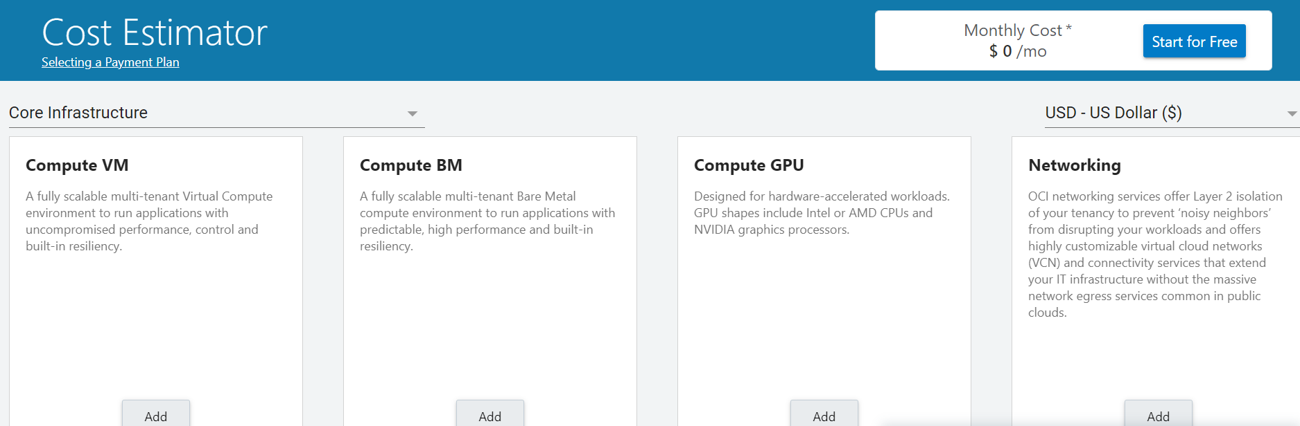
An example Oracle cloud Cost Estimation Tool…

Slide 47
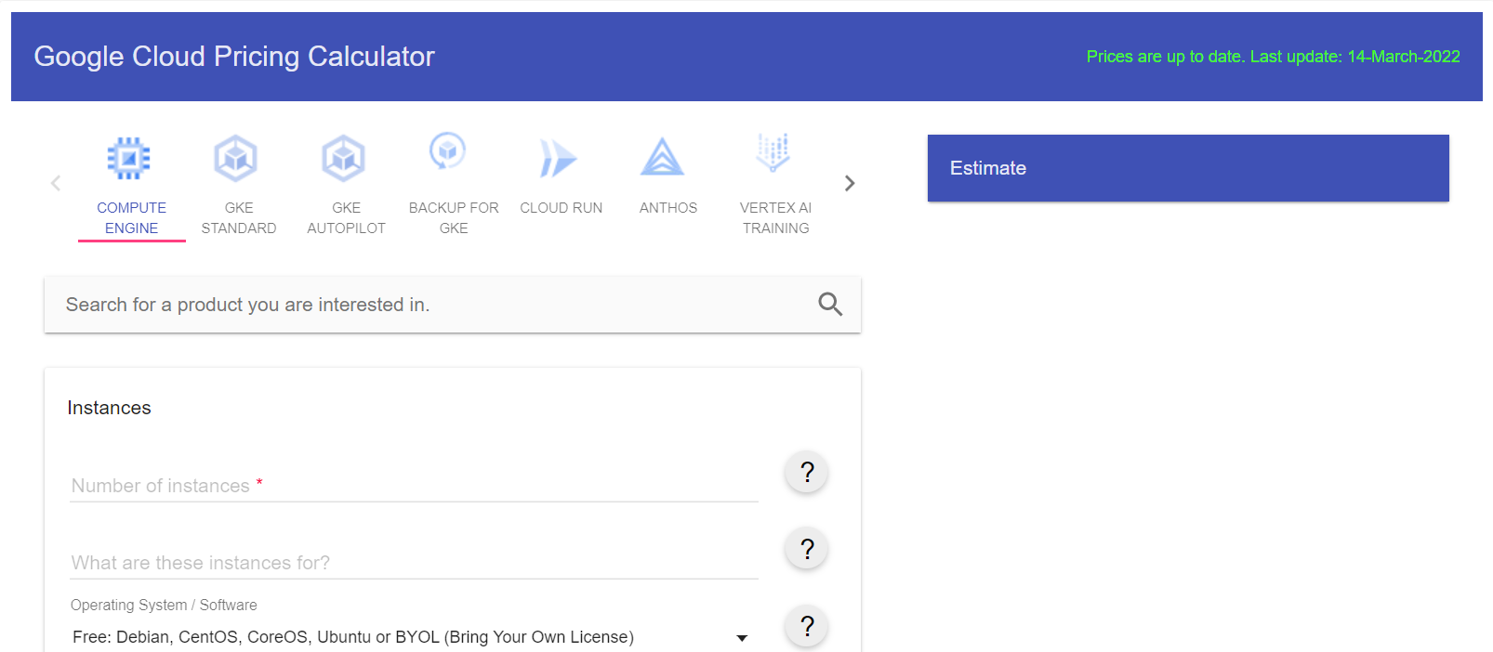
There’s one for google too…

